Slide 1
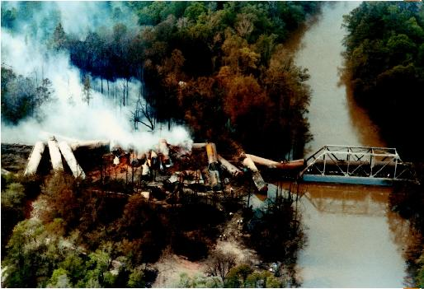
Hospital chemical disaster management
Robert G. Hendrickson, MD
Oregon Poison Center
Oregon Health and Science University
Portland, Oregon, USA

Slide 2
Objectives
Discuss real chemical disasters and their effects on hospitals
  Describe the characteristics of chemical disasters
Describe the necessary steps in hospital response:
  Incident command structure
  Emergency medicine’s role
  Toxicologist’s role

Slide 3
Chemical disasters
Tokyo Sarin Incident
Albertson, Montana - chlorine spill
Texas, October 1987 - HF release
Bhopal, India – methylisocyanate
Tianjin, China - Cyanide

Slide 4
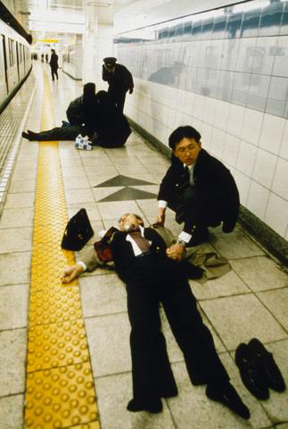
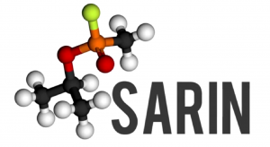
Tokyo 1995

Slide 5
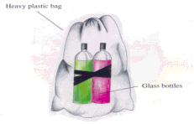
Tokyo, 1995
March 20, 1995, Tokyo, Japan
Aum Shinrikyo
7:55am - Plastic bags containing sarin placed below the seats of a subway car
Bags are punctured with the sharpened end of an umbrella

Slide 6
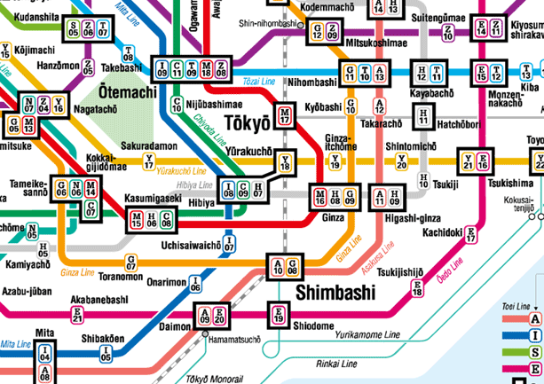
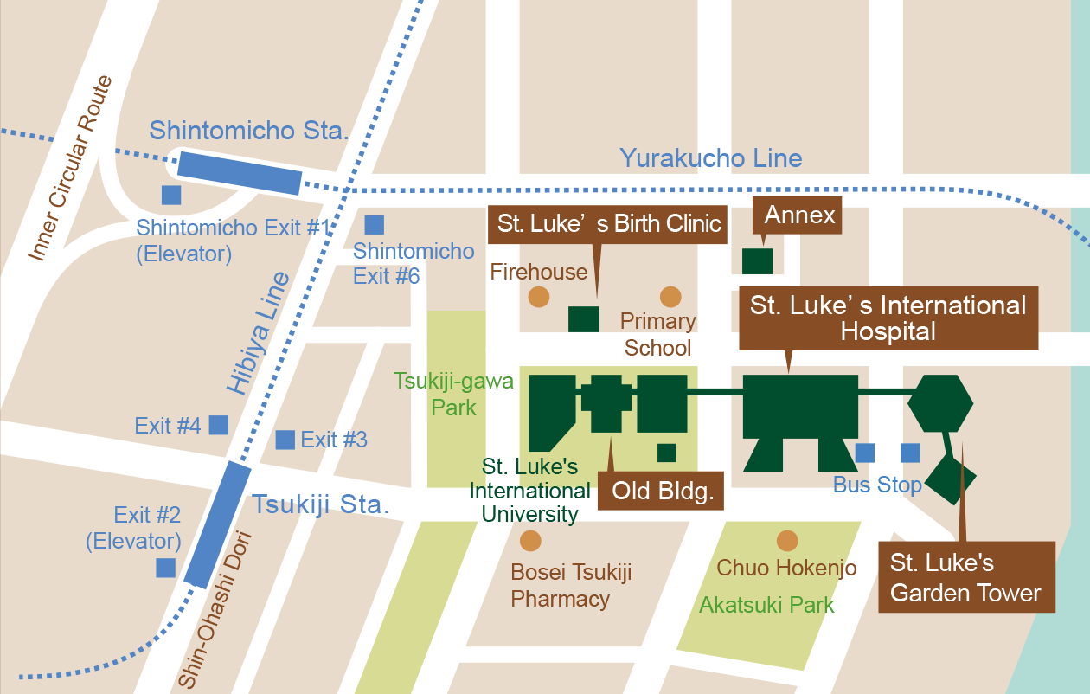
St. Luke’s Hospital, Tokyo
St. Luke’s Hospital is close to 6 subway stations and is the closest hospital to the event.
Notes:
Kasumigaseki = cabinet ministers
Nagatacho = elected government and legislative branch
5 subway cars on 3 lines
St Luke’s hospital is a 520 bed private hospital that is situated <3km from the attack

Slide 7
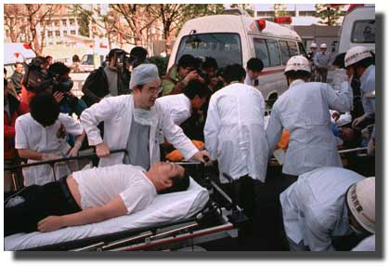
St. Luke’s Hospital, Tokyo
8:28am(33min)–1st ambulatory patient in ED
8:43am(48min)–1st ambulance arrives
Next hour –
  500 patients arrive in ED
  3 in cardiac arrest
  5 are pregnant

Slide 8


Slide 9
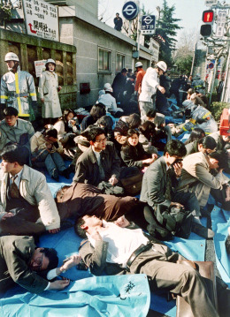
Tokyo
At the scene:

Slide 10
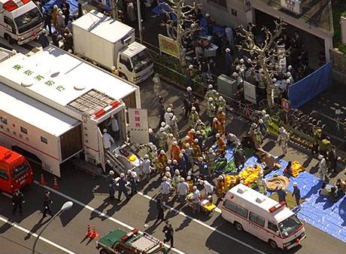
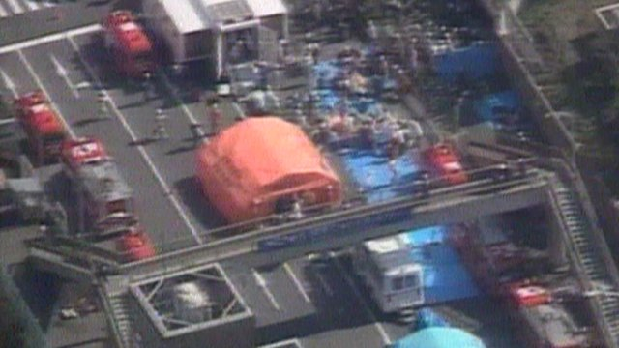
Tokyo
At the scene:

Slide 11
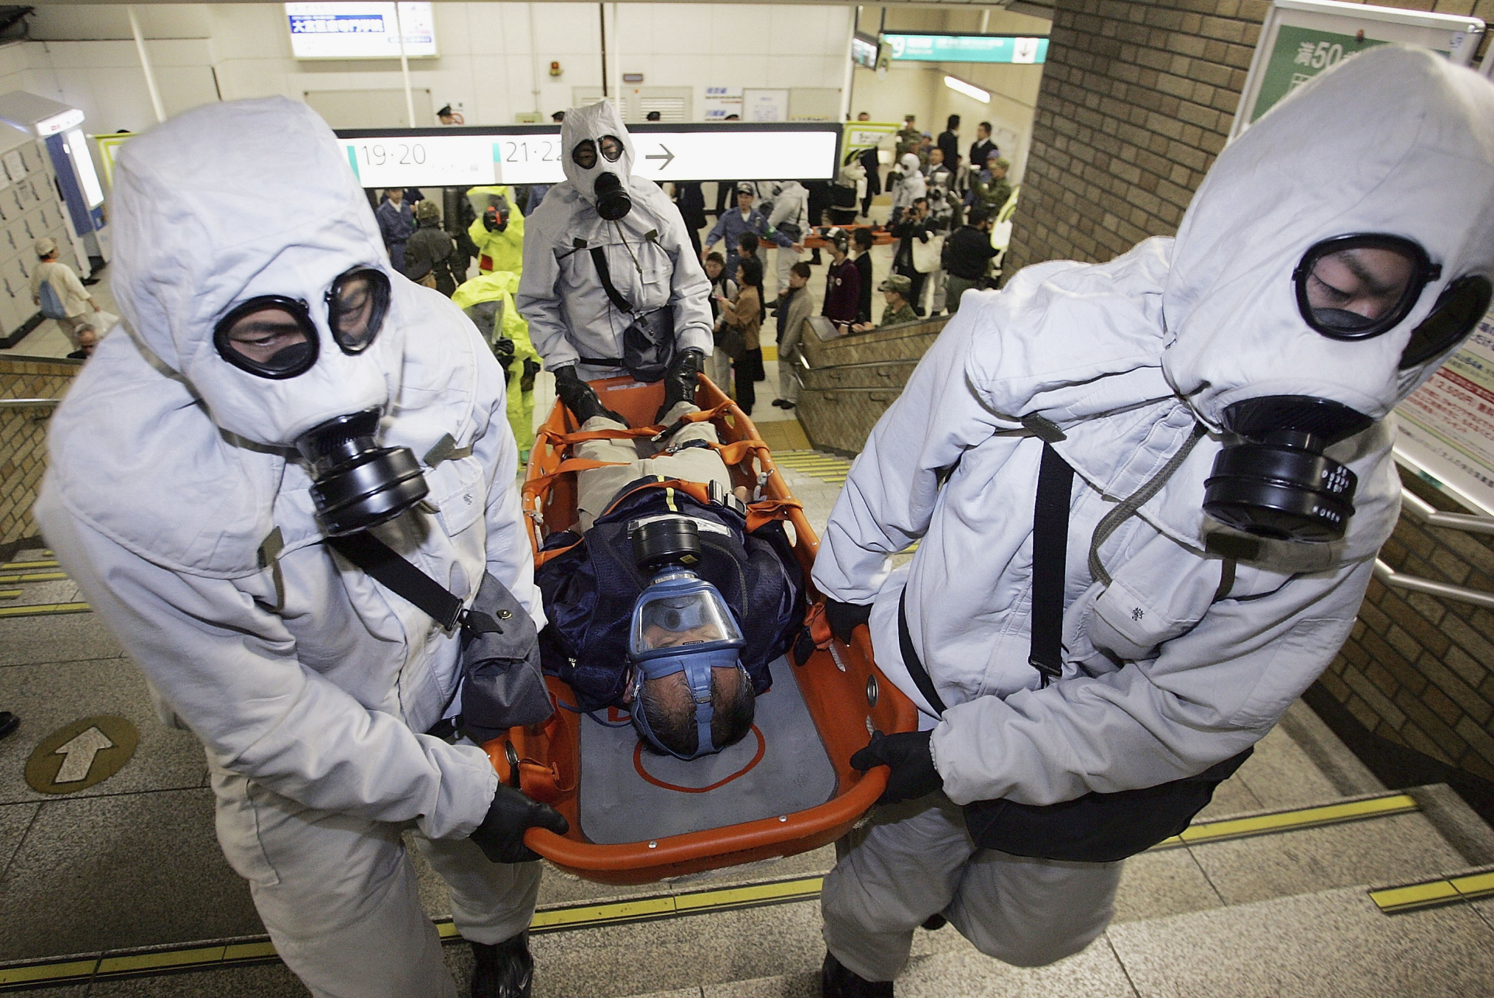

Slide 12
Tokyo
The first day…
  640 patients in the ED
    64 by ambulance / 35 by police
    541 by non-EMS transport
  Few had pre-hospital decontamination
  5 intubated
  107 “moderate” (SOB, sz, fasciculation)
  2 dead
Okumura T, et al. Ann Emerg Med 1996; 28(2): 129-135

Slide 13
Tokyo
729 additional patients over the next 4 days:
  3/21 116 pts
  3/22 319 pts
  3/23 204 pts
  3/24 90 pts
Okumura T, et al. Ann Emerg Med 1996; 28(2): 129-135

Slide 14
Tokyo
St. Luke’s Hospital
  Followed up 500 patients as outpatients over the next few weeks
Okumura T, et al. Ann Emerg Med 1996; 28(2): 129-135

Slide 15
Tokyo
23% of staff reported symptoms
  Nurses 26%
  Doctors 22%
  Volunteers 26%
  Nurse assistants 39%
  Clerks 18%
Okumura T, et al. Acad Emerg Med 1998; 5: 618-624

Slide 16
Tokyo
All hospitals:
  11 dead
  5000 patients sought emergency care
Okumura T, et al. Acad Emerg Med 1998; 5: 618-624

Slide 17
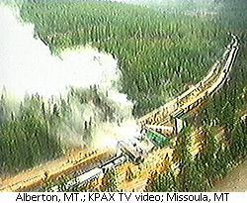
Alberton, MT

Slide 18
Alberton, MT
April 11, 1996, ~4am
4 tanker cars containing chlorine derailed on its way to a paper mill
122,000 pounds of chlorine spilled

Slide 19
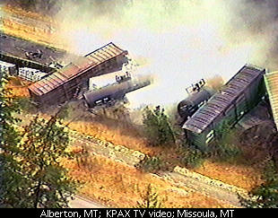
Alberton, MT
1000 people evacuated from Alberton and Frenchtown, MT
Over 500 patients in the hospital ED
352 hospitalized
1 dead
I-90 shut down for 19 days for cleanup

Slide 20
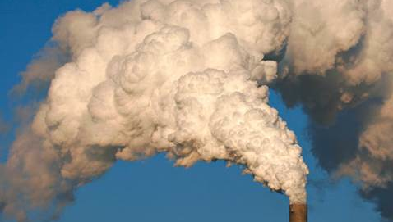
Texas, US, 1987

Slide 21
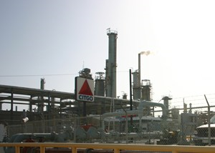
Texas - 1987
A petro-chemical plant accidentally released 53,000 pounds of hydrofluoric acid
HF formed vapor over a community of 41,000 people
Notes:
2 pipes containing isobutane-saturated HF were shearing during maintenance.
Cloud fell over town – 41K residents, homeocming night
Response swift:
Water curtain erected within 7 minutes
20min – all people within 0.8K were evacuated
Shortly after, 3000 people evacuated from a 8 km2 area

Slide 22
Texas - 1987
939 victims arrive at the hospital
  94 admitted to the hospital
  845 discharged
Downwind – over a 3.2km area
  Vegetation loss
  Car windows etched
Wing JS, et al. Arch Environ Health 1991; 46(3): 155-160

Slide 23
Texas - 1987
Symptoms
  Irritant
    62% eye/throat burning
    19% shortness of breath
    16% cough
  Nonspecific
    Headache 21%
    Vomiting 7%
  120 (14%) had no complaints
Wing JS, et al. Arch Environ Health 1991; 46(3): 155-160

Slide 24

Notes:
CO + chlorine yields phosgene, phosgene combined with monomethylamine to form MIC. MIC is mixed with naphthol to produce carbaryl.

Slide 25
Bhopal, India
Union Carbide plant in Bhopal, India, 1984
  Produced carbaryl (Sevin®), a carbamate pesticide
  CO + Cl₂ -> COCl₂ (phosgene)
  COCl₂ + CH₃NH₂ -> CH₃NHCOCl + HCl -> HCl + CH₃NCO (MIC)
  CH₃NCO (MIC) + naphthol -> carbaryl
Notes:
CO + chlorine yields phosgene, phosgene combined with monomethylamine to form MIC. MIC is mixed with naphthol to produce carbaryl.

Slide 26
Bhopal, India
Introduction of water into MIC storage tank -> uncontrollable hyperthermic reaction that releases:
  27 tons of methylisocyanate
  Safety systems fail:
    Flare tower (for burning off excess gas)
    Caustic soda scrubber (neutralization)
    Refrigeration unit
Notes:
CO + chlorine yields phosgene, phosgene combined with monomethylamine to form MIC. MIC is mixed with naphthol to produce carbaryl.

Slide 27
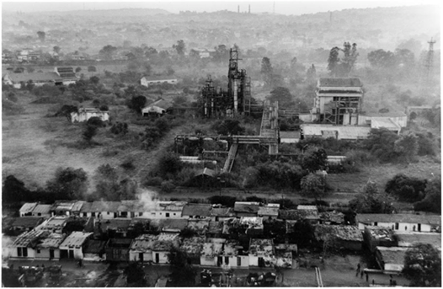
Bhopal, India
Notes:
CO + chlorine yields phosgene, phosgene combined with monomethylamine to form MIC. MIC is mixed with naphthol to produce carbaryl.

Slide 28
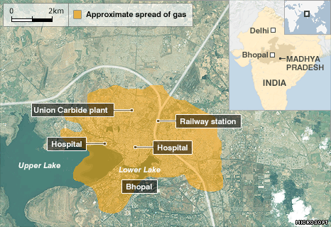

Slide 29
Bhopal, India
Methylisocyanate (MIC)
  Moderately soluble irritant gas
  May decompose to hydrogen cyanide, nitrogen dioxide, and carbon monoxide
Phosgene, CO, HCL are used in production and were also likely released

Slide 30
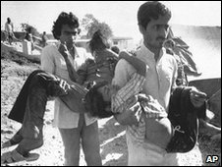
Bhopal, India
Weather:
  Thermal inversion
Initial mild mucosal irritation created panic and many left their homes to flee (entering into the MIC cloud)
  124/158 surveyed ran from homes
Dipersion modeling predicts ground-level concentrations from 0.12 ppm to 85.6ppm
OSHA PEL = 0.02ppm
NIOSH IDLH = 3ppm

Slide 31
Bhopal, India
200,000 exposed
  6000-12,000 deaths
  Early deaths = 300 autopsies = necrotizing lesions of respiratory tract
  Later deaths mostly from respiratory failure and respiratory infections

Slide 32
Bhopal, India
3 month follow up:
  18% had abn CXR
  39% abn spirometry
  33% respiratory symptoms
    Symptoms correlated inversely with distance to plant
  Biopsies: interstitial fibrosis and bronchiolitis obliterans, similar to animal studies

Slide 33
Bhopal, India
10 year follow up:
  Respiratory symptoms correlate with predicted dose of MIC
  FEV _{25-75%} (small airway obstruction) declined linearly with distance to plant

Slide 34
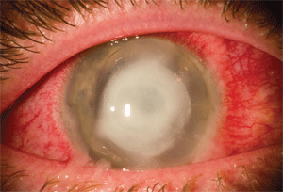
Bhopal, India
Bhopal eye syndrome – 1000s
  Initial keratopathy, chemosis, corneal ulceration
  Chronic eye watering, photophobia, irritation

Slide 35
Tianjin, China, 2015

Slide 36
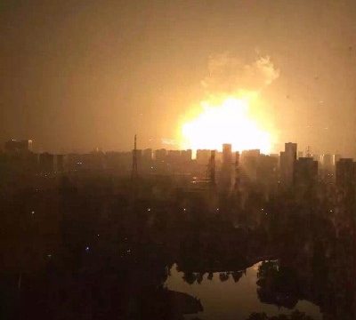
Tianjin, China, 2015
Fire, followed by several explosions at hazardous container storage facility
  Ammonium and potassium nitrate (1300 tonnes)
  Sodium cyanide (700 tonnes)

Slide 38
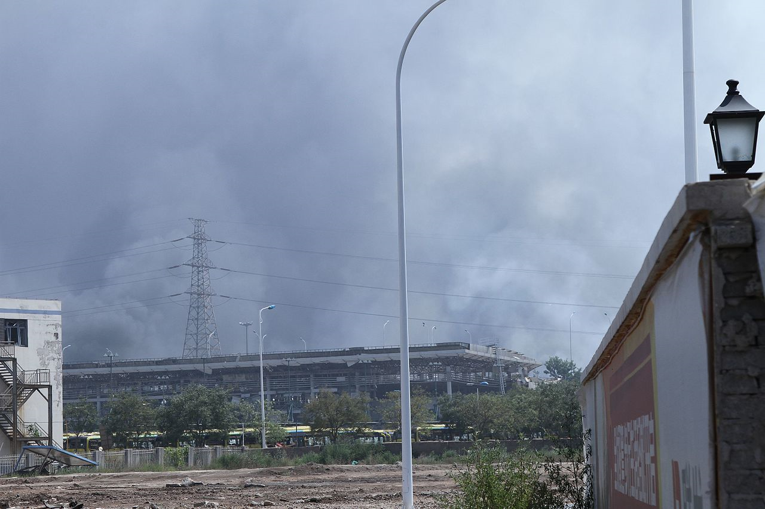
Tianjin, China, 2015

Slide 39
Tianjin, China, 2015
Detected in air after the explosion:
  Sulfur dioxide
  Carbon monoxide
  Nitrogen dioxide
  Trace cyanide –
    Envir Prot Bd advised public to avoid the rain
    1000s of dead fish
Evacuation of 3km radius of site

Slide 40
Tianjin, China, 2015
Casualties:
  159 deaths
  797 injuries

Slide 41
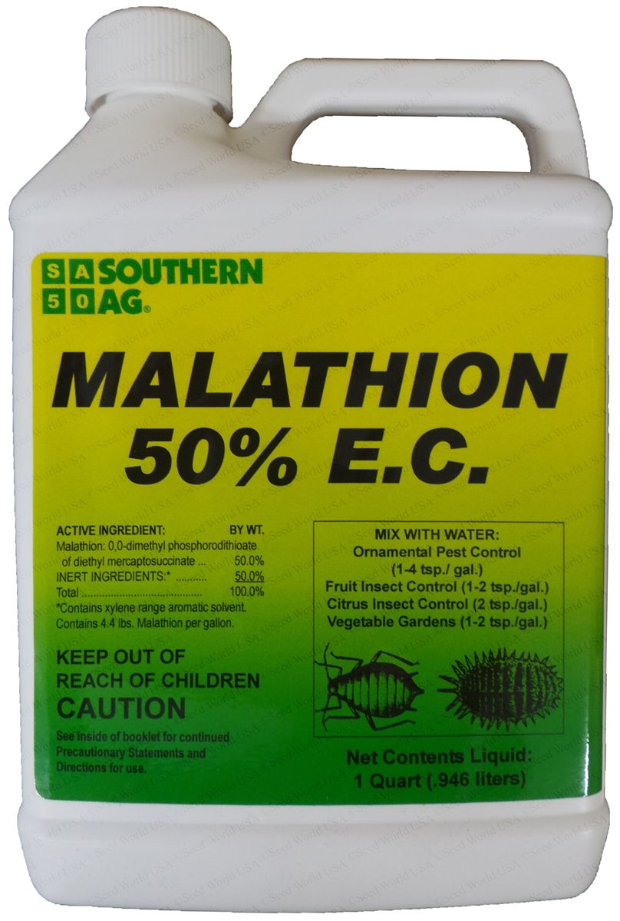
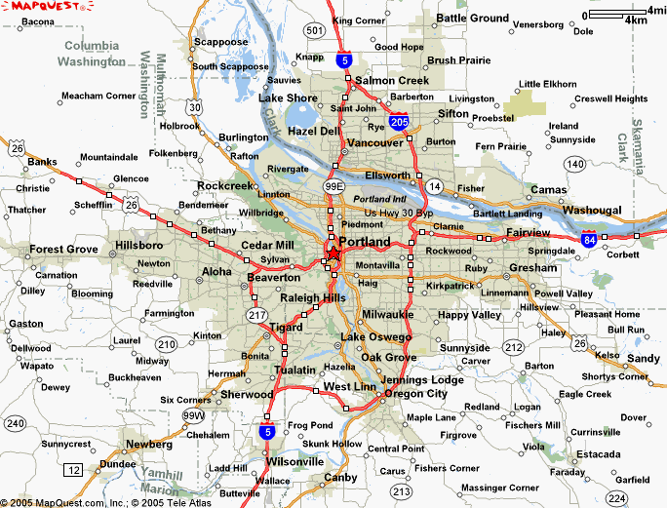
Portland, OR, USA

Slide 42
Portland, OR, USA
September, 2003
  Intentional suicidal ingestion of malathion
  Transported by ambulance
  Patient arrives
    Unconscious
    Diaphoretic, vomiting, salivating
  Brought into ED

Slide 43
Portland, OR, USA
Treatment
  Intubation
  Atropine (24 mg over 24 hrs)
  2-pam
  Diazepam
  Clothing removed and left on floor

Slide 44
Portland, OR, USA
ED overwhelmed by odor
  Other patients develop respiratory and eye symptoms
  Paramedics develop symptoms
  ED doors opened and fans brought in to ventilate
  Ambulance out of service
  ED closed for > 6 hours

Slide 45
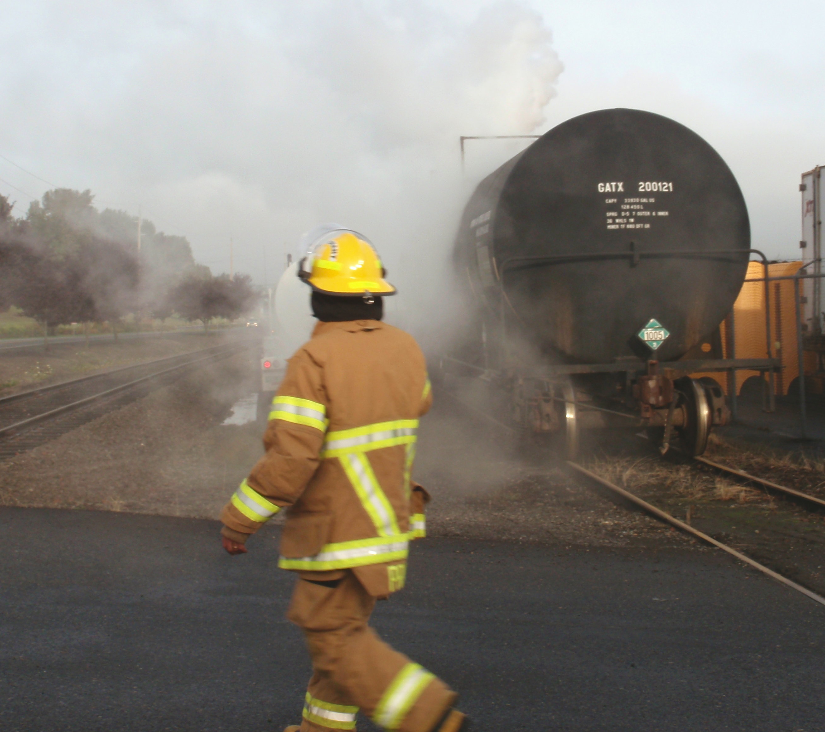
What are the characteristics of chemical disasters?

Slide 46
Characteristics of chemical disasters
Potential for large numbers of patients
  Chemical events may be mass casualty incidents with 100s-1000s of patients
    Hospitals may be overwhelmed within 1-2 hours (e.g. Tokyo)
  Some patients may be severely symptomatic
  Potential for many dead
  Most patients are asymptomatic, scared, and are seeking information
Notes:
Alberton = 500 patients; Tianjin = 800 injured; Texas = 700 patients; Tokyo = 600 patients; Bhopal = 200,000 symptomatic, 2,000 die in one night
Alberton 350/500 admitted (70%); Texas 10% admitted; Bhopal 2000 dead; Tianjin 150 dead
Possibility of 100s of information seekers

Slide 47
Characteristics of chemical disasters
There is a delay of about 20-30 minutes before patients arrive
  Time to prepare decontamination facility?
The first patients arrive in cars – without pre-hospital triage or decontamination (90%)
More critically ill patients may arrive later via ambulance

Slide 48
Characteristics of chemical disasters
Chemical releases may occur from:
  Transport of chemicals (train or truck)
    Tend to be smaller releases, but may lead to large numbers of casualties
  Fixed facilities
    May be larger, but less common
    Allow for prior planning
Notes:
Is there an alert system for transport of chemicals in cities
1986, Emergency Planning and Community Right-to-Know Act
Requires companies to make their storage of chemicals publicly available

Slide 49
Characteristics of chemical disasters
High volume of affected patients continues for > 1 week even though the event is short lived
Patient symptoms may be non-specific and difficult to diagnose:
  Nausea, headache, dyspnea

Slide 50
Characteristics of chemical disasters
Hospital workers, ambulances, pre-hospital personnel may be:
  Contaminated
  Symptomatic
  Become patients
  Unable to continue to work
Even a single contaminated patient may:
  Contaminate the hospital
  Close the ED
  Take ambulances and ED facilities out of the response

Slide 51
Characteristics of chemical disasters
Other characteristics of chemical disasters:
  Most exposures are vapor or aerosol
  Most chemicals can be decontaminated with removal of clothes and very brief wash with soap and water
  Most chemicals are treated with general supportive care
    Very few require antidotes

Slide 52
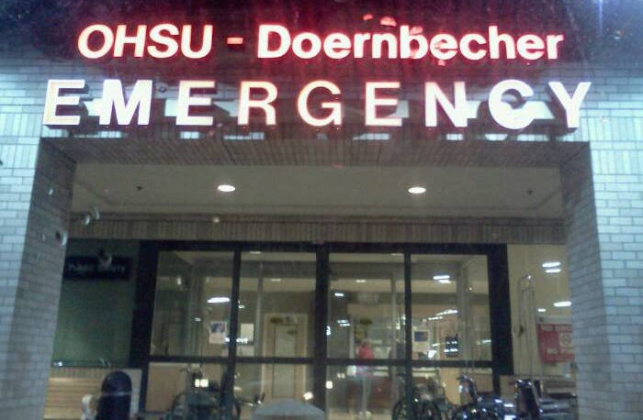
What do emergency departments need?

Slide 53
What do emergency departments need?
Rapid decontamination
  Facilities – external to emergency department
  Personnel
  Training
  Regular exercises

Slide 54
What do emergency departments need?
Mass triage
  Facilities
  Personnel
  Training
  Regular exercises

Slide 55
What do emergency departments need?
Readily available equipment
  Decontamination facilities
  PPE for decontamination as well as universal precautions
  ? Radiation supplies
    Radiation survey meter
  Regular training on the use of all of these

Slide 56
What do emergency departments need?
What do emergency departments need?
  Hospital response
  Information about substance (coordination with public health agencies)

Slide 57
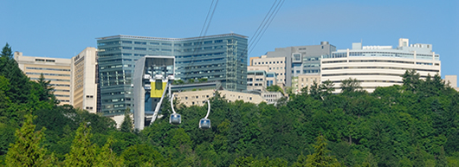
What is a hospital response?

Slide 58

Hospital response to disasters
Method to rapidly collect decision makers
  Initially via phone
  Then physically
    Hospital Emergency Operations Center

Slide 59
Hospital response to disasters
Hospitals should use a defined and structured command system
  Incident command system

Slide 60
Incident Commander
Security Officer
Liaison Officer
Public Info. Officer
Safety Officer
Operations Chief
Logistics/Resource
Planning
Finance
Laboratory
IT/Telecom
Sit. Status
Time Tracking
Medical Director
Materials Supply
Pharmacy
Nursing staffing
Claims
Amb Services
Nutrition Supply
HR
Radiology
Costs
Transportation
Staffing Office
Inpatient area
Treatment area
Procurement
Psychological
support
Triage area
Surg Services
Immediate treatment
Mother/Baby
Delayed treatment
Crit Care
OHSU Hospital
Initial Incident
Command Structure
Nursing units
Minor Treatment
Discharge
Patient tracking leader
Morgue

Slide 61
Emergency Physician’s Role in a chemical disaster
Identify changes in patterns
  Increased intubations
  Large volume of patients with mucosal irritation
  Reports of an explosion
Activate a hospital-wide disaster response
  Hospital-specific reporting system
  Regional disaster response

Slide 62
Emergency Physician’s Role in a chemical disaster
Chemicals
  Make decisions regarding decontamination and treatment/antidotes
Mostly, though, do what you always do
  treat patients
Command structure
  Vests/identification as a leader
  Don’t solve problems – identify them

Slide 63
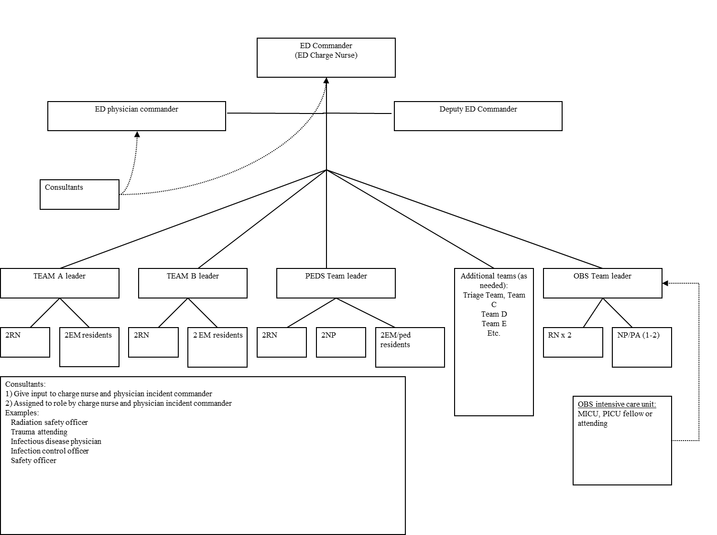
Emergency Physician’s Role in a chemical disaster

Slide 64
Poison Center/Toxicologist’s role in a disaster
Act as a source of information for clinicians on the chemical
  Must be connected to the regional response
    Fire, EMS, and all local hospitals
  Rapid way in which to transmit one-way information
    Blast fax
    Internet/web site/twitter

Slide 65
Poison Center/Toxicologist’s role in a disaster
Act as a source of information for clinicians on the chemical
  Caveats:
    Most initial information is incorrect
    May need to determine toxidrome via descriptions over the phone
    Determine:
      If decontamination is necessary
      If an antidote is needed

Slide 66
Poison Center/Toxicologist’s role in a disaster
Act as a source of information for media and hospitals/clinicians
  Clear and rapid communication with clinicians
  Clear and rapid communications with the media and public

Slide 67
Poison Center/Toxicologist’s role in a disaster
Where do you get information about chemicals?
  Dr. Google???

Slide 68
Material Safety Data Sheet (MSDS)

Slide 69
CDC

Slide 70
ATSDR

Slide 71
Oregon Poison Center Fact Sheets

Slide 72
Conclusions
Chemical events:
  Occur frequently
  May occur from fixed or mobile facilities
  May produce many casualties
  May require rapid communication and coordination of services, specialized care, decontamination, and transport of antidotes
  Hospitals require advanced planning and coordination with regional resources to respond appropriately to chemical event

Slide 73
A case…
Imagine that it is 9am on a Monday morning…
  You feel the ground shake a little
  Then a loud explosion

